Slide 1

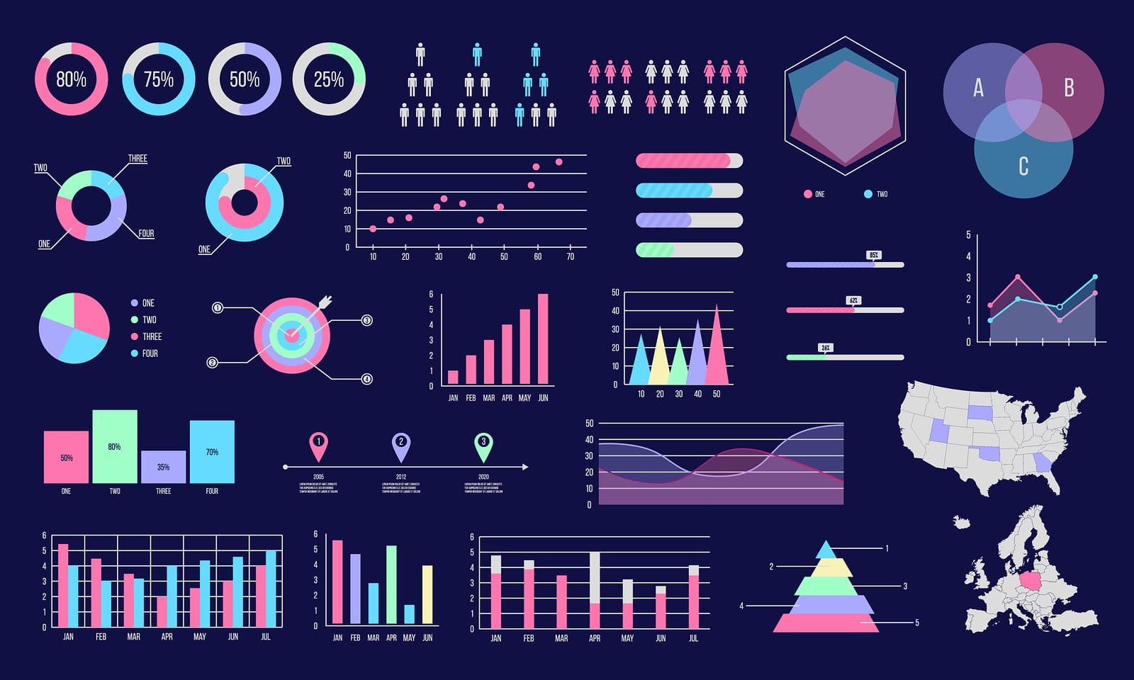
E-commerce Funnel Visualization: Insights from User Behavior
Anuj Patel (002874710)
Jaimin Patel (002419803)

Slide 2

Understanding the E-commerce Funnel
Key Points:
Problem: Significant user drop-off occurs during the purchase journey, making conversion a challenge.
Importance: Identifying and addressing these drop-offs can improve conversion rates and revenue.
Insight Opportunities: Analyze where users disengage, which categories perform best, and how behaviors lead to purchases.
Goal: Provide actionable insights to improve user experience and drive sales.

Slide 3
Data Source and Approach
Dataset: Taobao User Behavior Data (Nov 25 - Dec 2, 2017)
Scale:
86.9M interactions
987K users
3.9M items
Features: UserID, ItemID, CategoryID, BehaviorType (view, cart, favorite, buy), Timestamp
Approach:
Data Processing: Python (pandas)
Visualization: Interactive funnel charts, time series plots (Plotly/Dash)
Analysis: Calculate conversion rates, identify drop-offs

Slide 4

Expected Outcomes and Deliverables
Expected Outcomes:
Interactive tool for visualizing and analyzing the e-commerce funnel
Insights into user behavior patterns and conversion bottlenecks
Actionable recommendations for improving conversion rates
Deliverables:
Software tool (built with Python, Dash/Plotly)
Final report with analysis and insights
Presentation of findings and tool demo

